Slide 1

Enhancing Hospitality: IslandRest Hostel Operational Overview

Slide 2











PROBLEM STATEMENT
Workers commuting daily from Lagos mainland to Lagos Island face formidable challenges that undermine their productivity and well-being. Severe traffic congestion on critical routes like the Third Mainland Bridge results in exhausting commutes exceeding two hours each way.
The financial burden of daily transportation costs, whether through private vehicles or ride-hailing services, compounds the stress of commuting. Meanwhile, the exorbitant cost of living on Lagos Island leaves many workers unable to afford housing close to their workplaces, necessitating long, arduous journeys.
Existing public transportation systems are overburdened, unreliable, and often fail to adequately cover all commuting needs, further exacerbating the challenges faced by workers. Overcrowding and frequent delays add to the daily stress and inefficiency of the commute.

Slide 3






PROBLEM STATEMENT
The cumulative impact of prolonged commuting—coupled with safety risks during early morning and late evening hours—adversely affects workers' physical and mental health. Heightened stress levels contribute to decreased productivity and increased absenteeism, compromising overall job performance.
Long commute times rob workers of precious personal time, affecting their ability to engage in family life, personal activities, and adequate rest. The imbalance created between work and personal life perpetuates a cycle of stress and dissatisfaction among employees.

Slide 4

Existing Solutions to Commuting and Housing Challenges in Lagos
Several approaches have been attempted to address the commuting and housing challenges faced by Lagos workers, particularly those commuting between the mainland and Lagos Island. Below are some of the notable solutions along with scholarly citations.
1
Improved Public Transportation Infrastructure - Bus Rapid Transit (BRT) System
Lagos introduced the BRT system in 2008 to provide a more efficient and reliable public transportation option. The BRT system uses dedicated lanes to reduce travel time and alleviate traffic congestion.
"The implementation of the BRT system in Lagos has significantly improved the efficiency of public transportation, reducing travel time for commuters" (Oni & Okanlawon, 2011).
2
Development of Affordable Housing Projects - Public-Private Partnerships (PPP)
The Lagos State Government has engaged in PPPs to develop affordable housing units aimed at reducing the housing deficit. Projects like the Lagos Homes scheme have been initiated to provide affordable housing for middle and low-income earners.
"Public-private partnerships in Lagos have facilitated the development of affordable housing, addressing the significant housing deficit in the city" (Ibem, 2011).
3
Improved Public Transportation Infrastructure - Ride-Hailing Platforms
Services like Uber and Bolt have become popular in Lagos, offering a convenient alternative to traditional public transportation. These services provide flexible and relatively efficient commuting options for those who can afford them.
"Ride-hailing services have emerged as a significant alternative to traditional public transportation in Lagos, offering flexibility and convenience to commuters" (Afolabi & Gbadamosi, 2017).

Slide 5
Existing Solutions to Commuting and Housing Challenges in Lagos
4
Expansion of Rail Services - Lagos Light Rail Project
The Lagos State Government has been developing the Lagos Rail Mass Transit (LRMT) system to provide a more efficient and large-capacity public transport option. The Blue Line, which connects the mainland to Lagos Island, is a major part of this initiative.
"The Lagos Light Rail Project is expected to significantly enhance public transportation efficiency and reduce congestion on key commuter routes" (Olukoju, 2003).
5
Employee Shuttle Services - Corporate Shuttle Services
Some organizations provide shuttle services for their employees, reducing the need for individual commuting and helping to manage travel schedules more effectively. This initiative helps in reducing the number of cars on the road, thereby alleviating traffic congestion.
"Employee shuttle services have been shown to effectively reduce traffic congestion and improve commuting efficiency for corporate workers" (Adeola, 2010).
6
Co-Living Spaces - Co-Living Communities
Co-living spaces provide shared living arrangements, often with communal facilities and a focus on community and networking. These spaces are designed to offer affordable living solutions, especially for young professionals and remote workers.
"Co-living spaces represent an innovative approach to urban housing, fostering community while addressing affordability and convenience" (Ting & Chien, 2013).

Slide 6

While these solutions have contributed to addressing some aspects of the commuting and housing challenges in Lagos, significant gaps remain, particularly in terms of affordable and convenient housing options near workplaces on Lagos Island.
The proposed co-accommodation hostel project aims to fill this gap by providing a cost-effective and practical solution for workers, thereby enhancing their overall quality of life and productivity.

Slide 7




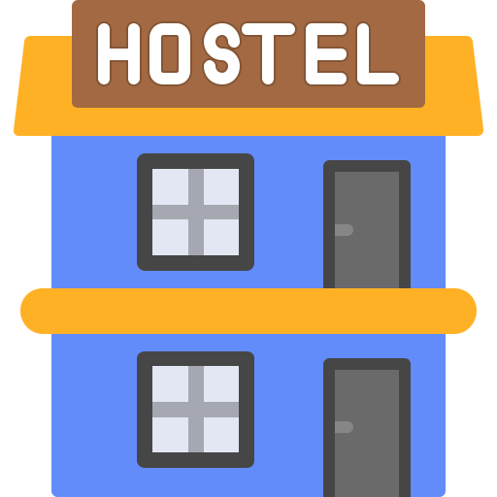
Discoveries and Opportunities
High Demand for Affordable Housing
Potential for Co-Accommodation Hostels
Enhanced Productivity and Well-being
There is a substantial demand for affordable housing in Lagos, especially on Lagos Island, where the cost of living is considerably higher compared to the mainland. Workers commuting from the mainland to the island daily are in dire need of economical lodging options closer to their workplaces.
The concept of co-accommodation hostels presents a viable solution to the housing and commuting challenges in Lagos. These hostels can offer affordable, convenient, and secure lodging for workers, reducing commute times and improving their quality of life.
Reducing commute times and providing convenient housing solutions can significantly enhance workers' productivity and overall well-being. Long commutes are associated with increased stress, health issues, and reduced job satisfaction.
~(Smith, 2014).
~(Koslowsky et al., 1995).
~(Akinmoladun & Oluwoye, 2007).

Slide 8



Discoveries and Opportunities
Leveraging Public-Private Partnerships
Technological Integration
Economic Impact
Public-private partnerships (PPPs) can play a crucial role in developing co-accommodation hostels. By collaborating with private developers, the government can facilitate the creation of affordable housing projects that meet the needs of the commuting workforce.
The integration of technology in managing co-accommodation hostels can enhance security, efficiency, and user experience. Technologies such as online booking systems, smart locks, and CCTV can ensure a seamless and secure living environment for residents.
Providing affordable and convenient housing solutions can have a positive economic impact on the city. Reduced commute times can lead to higher productivity, lower absenteeism, and greater overall economic output.
(Glaeser & Kahn, 2004).
~(Li et al., 2005).
~(Hamari et al., 2016).

Slide 9


The discoveries highlight the critical need for innovative housing solutions to address the commuting and housing challenges in Lagos. The concept of co-accommodation hostels presents a promising opportunity to enhance the quality of life for workers, reduce commute times, and improve economic productivity. By leveraging public-private partnerships and integrating technology, these hostels can provide a sustainable and effective solution to the pressing issues faced by the commuting workforce in Lagos.

Slide 10
SWOT Analysis
S
O
Strengths
Opportunities
Cost-effective lodging options attract workers with high living costs.
Strategic location reduces commuting time, improving work-life balance.
Robust vetting and CCTV ensure a safe environment.
Promotes networking opportunities for diverse industry professionals.
Increased demand for affordable housing near expanding businesses.
Collaborations secure steady guests and generate long-term contracts.
Successful implementation can lead to expansion in similar areas.
Enhances customer experience and efficiency through seamless booking management.
W
T
Weaknesses
Threats
Fluctuations affect affordability of budget-friendly accommodation solutions.
Budget hotels, Airbnb, similar hostels impact market share.
Compliance challenges from changing local housing and business regulations.
Potential security breaches impact hostel's reputation and safety.
Substantial investment required for property, technology, and security.
Success relies on continuous demand for short-term accommodations.
Managing bookings, vetting, and standards is complex and resource-intensive.

Slide 11






Pestel Analysis
Nigeria's economy influences consumer spending and demand.
High inflation raises costs, affecting pricing strategies.
Higher employment increases demand for affordable housing.
Use advanced platforms for enhanced customer experience.
Implement biometric verification and real-time surveillance.
Leverage social media for marketing and engagement.
Follow local property and business operation laws.
Ensure compliance to protect guests and employees.
P
S
E
E
T
L
Local laws impact hostel operations and compliance.
Policies on infrastructure and housing influence development support.
More businesses increase demand for convenient housing.
Design accommodations considering local cultural norms.
Leverage networking desires of young professionals.
Use energy-efficient facilities and effective waste management.
Account for climate change and extreme weather events.

Slide 12





Security: 24/7 security personnel, CCTV surveillance, and secure access control systems.
Cleaning Services: Regular cleaning of rooms and common areas to ensure a hygienic living environment.
Community Events: Regularly organized events to promote interaction and networking among residents.
About
Lagos Co-Accommodation Hostels (LCAH) is a pioneering initiative designed to provide affordable, convenient, and secure living arrangements for professionals working on Lagos Island. Recognizing the challenges posed by daily commutes from the mainland to the island, LCAH aims to bridge the gap by offering co-living spaces that cater to the needs of the modern workforce. Our hostels are designed to foster community, enhance productivity, and improve the overall quality of life for our residents
Mission:
Lagos Co-Accommodation Hostels (LCAH) is set to revolutionize urban housing in Lagos by providing affordable, convenient, and secure living spaces for professionals. Our commitment to community, innovation, and sustainability positions us as a leader in the co-living sector, addressing the critical needs of Lagos' commuting workforce and contributing to the city's economic and social well-being.
To provide affordable and convenient co-accommodation solutions that reduce commuting stress and enhance the quality of life for professionals working on Lagos Island.
Core Values:
Affordability: We are committed to offering cost-effective housing solutions without compromising on quality and comfort.
Convenience: Our facilities are strategically located to minimize commute times and maximize the convenience of our residents.
Community: We foster a sense of community among our residents, encouraging networking and mutual support.
Security: Ensuring the safety and security of our residents is paramount, with robust measures in place to protect them.
Innovation: We continually seek innovative approaches to improve our services and enhance the living experience for our residents.
Sustainability: We prioritize environmentally sustainable practices in the development and operation of our hostels.
Vision:
To become the leading provider of innovative and sustainable co-living solutions in Lagos, setting a benchmark for quality, community, and convenience in urban housing.
Services:
Affordable Accommodation: Offering various room categories (2, 4, and 8 beds per room) to suit different budgets.
Amenities: Each room includes essential amenities such as bathrooms, toilets, and comfortable bedding.
Dining Options: On-site restaurant and cafeteria providing nutritious and affordable meals.

Slide 13
Target Market
Commuting Professionals
Remote and Freelance Workers
Workers commuting to Lagos Island from the mainland, seeking affordable and convenient lodging.
Individuals who require temporary accommodation while working on projects in Lagos Island.
Young Graduates
Business Travelers
Recently employed graduates who are looking for cost-effective housing solutions near their workplaces.
Professionals visiting Lagos Island for business purposes and needs affordable and secure accommodation.

Slide 14








Competitive Advantage
Strategic Location
Cost-Effective Solutions
Proximity to major business hubs on Lagos Island reduces commute times.
More affordable than traditional hotels, AirBnBs, or short-let apartments.
Quality and Comfort
Safety and Security
High standards of accommodation with essential amenities and regular maintenance.
Comprehensive security measures to ensure the safety of all residents.
Community Focus
Creating a supportive community environment that enhances the living experience.

Slide 15





Management Team
Founder & CEO
Operations Manager
Marketing Director
Head of Security
Facilities Manager

Slide 16






Financial Projections
LCAH aims to achieve financial sustainability within the first two years of operation.
Key revenue streams include:
Rental fees
Dining services
Community events
Initial funding requirements will cover the costs of property acquisition, renovation, security systems, and marketing.

Slide 17







Product Specification
Room Amenities
Room Categories
Beds: Comfortable mattresses, pillows, and linens provided.
Storage: Individual lockers or storage units for personal belongings.
Bathrooms: Each room has an en-suite bathroom equipped with a shower, toilet, and sink. Bathrooms are cleaned daily.
Wi-Fi: High-speed internet access available in all rooms and common areas.
Climate Control: Air conditioning and heating systems to ensure comfort year-round.
Safety Features: Smoke detectors, fire extinguishers, and emergency exits in each room.
Two-Person Rooms: Designed for those who prefer a quieter environment with fewer roommates. Each room features two single beds or a bunk bed, individual storage units, and a shared bathroom.
Four-Person Rooms: Ideal for small groups or individuals who enjoy a balance of privacy and social interaction. Rooms include two bunk beds, personal lockers, and a shared bathroom.
Eight-Person Rooms: Perfect for those looking for the most economical option. These rooms have four bunk beds, individual storage lockers, and a shared bathroom.

Slide 18
Common Areas
Security Measures
Lounge
A communal space with seating, televisions, and reading materials for relaxation and socialization.
1
24/7 Security Personnel
Trained security staff present at all times.
2
CCTV Surveillance
Cameras installed in common areas and entrances for continuous monitoring.
Dining Area
A cafeteria or restaurant providing breakfast, lunch, and dinner.
3
Secure Access
Key card or biometric access to rooms and facilities to ensure only authorized individuals can enter.
Laundry Facilities
On-site laundry rooms equipped with washers and dryers.
Kitchenette
Shared kitchen facilities for residents who prefer to cook their meals.
4
Emergency Protocols
Clear instructions and regular drills for emergencies such as fire or medical situations.

Slide 19

Sustainability
2. Energy and Water Conservation
LED Lighting: Installation of energy-efficient LED lights throughout the facilities.
Smart Thermostats: Use of programmable thermostats to optimize heating and cooling systems.
Water-Saving Fixtures: Low-flow showers, faucets, and toilets to minimize water usage.
Rainwater Harvesting: Systems in place to collect and use rainwater for irrigation and other non-potable needs.
1. Sustainable Building Practices
Energy-Efficient Construction: Use of sustainable materials and energy-efficient designs to reduce the environmental footprint.
Green Roofing: Installation of green roofs where feasible to improve insulation and promote biodiversity.
Solar Panels: Utilization of solar energy to reduce reliance on non-renewable energy sources.
4. Community Engagement
Sustainability Workshops: Regular workshops and educational sessions for residents on sustainable living practices.
Green Initiatives: Encouraging residents to participate in community gardening, clean-up drives, and other environmental initiatives.
Eco-Friendly Transportation: Providing information and incentives for using public transport, biking, or carpooling.
3. Waste Management
Recycling Programs: Comprehensive recycling facilities to encourage waste segregation and recycling among residents.
Composting: Organic waste from the kitchen and dining areas is composted and used for landscaping.
Minimal Plastic Use: Reduction of single-use plastics by providing reusable alternatives and encouraging their use among residents.

Slide 20
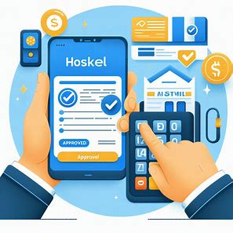


Life Cycle use-case
Applicants are notified upon successful vetting, receive booking details, and complete payment based on room category and stay duration.
Booking Confirmation
Pre-Arrival Vetting
Prospective guests submit applications with personal and employment details, undergo thorough verification.
Guests present booking confirmation, undergo additional ID verification, receive orientation on policies and amenities, and are given key cards or biometric access for rooms and common areas.
Check-In Procedure

Slide 21



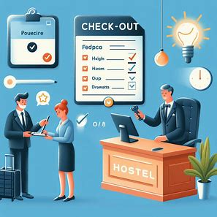
Rooms accessible 9 PM - 9 AM; guests vacate for cleaning. Regular patrols and CCTV monitoring for safety. Community activities for networking. On-site cafeteria offers diverse meals. Laundry rooms available. Staff assist with maintenance.
Analyze collected feedback and data for improvements. Securely store guest information for future reference while maintaining confidentiality.
Post-Departure Follow-Up
During the Stay
Guests notify the front desk 24 hours before check-out. Rooms are inspected for damages. Feedback is collected for service improvement. Key cards or access devices are returned.
Incident Management
Clear protocols for emergencies, including medical and security threats. Staff trained in conflict resolution to ensure a harmonious living environment.
Check-Out Procedure

Slide 22




Additional Security Measures
Random Checks
Occasional random checks are conducted to ensure compliance with hostel policies.
Guest Identification
Each guest is issued a photo ID specific to LCAH to facilitate easy identification by staff.
Security Drills
Regular security drills are conducted to ensure guests are familiar with emergency procedures.

Slide 23
Value Proposition
Convenient, affordable, safe lodging; fosters professional networking
Gain creators
Gains
Affordable hostels, amenities, security, networking events.
Long commutes, high rents, safety concerns, limited networking.
Products & services
Customer jobs
Comfort, networking, security, and on-site support.
Pain relievers
Pains
Affordable lodging, professional networking, and feeling secure.
Convenient, cost-effective, secure, structured networking environment.

Slide 24
Business Model
Key Partners Local businesses for amenities and services (cafeteria, laundry). Companies on Lagos Island for employee accommodations. Security firms for vetting and surveillance. Real estate agencies for property management and expansion. | Key Activities Managing bookings and guest vetting processes. Maintaining and securing the property. Organizing community events and activities. Marketing and promotion to attract new guests and corporate partners. | Value Proportions Affordable and convenient accommodation near workplaces on Lagos Island. Safe and secure environment with rigorous vetting processes. Community-oriented living space promoting networking and collaboration. Comprehensive amenities including dining, laundry, and common areas. |  | Customer Relationship Personalized service with dedicated support staff. Regular feedback collection and improvement based on guest experiences. Community engagement through events and activities. Loyalty programs and discounts for repeat customers. | Customer Segments Professionals working on Lagos Island. Companies looking to provide accommodation for their employees. Individuals commuting from the mainland to the island. Tourists and visitors looking for affordable lodging options.
 | Key Resources Property and facilities on Lagos Island. Technology platform for booking and management. Security infrastructure including CCTV and vetting processes. Staff including management, support, and security personnel. |  |  | Channels Online booking platform and mobile app. Partnerships with companies for bulk bookings. Marketing through social media, business forums, and networking events. Word of mouth and referrals from satisfied guests.
Cost Structure Property rental or acquisition costs. Maintenance and operational costs (utilities, cleaning, staff salaries). Marketing and promotional expenses. Technology development and maintenance. Security measures and personnel. |  |  | Revenue Streams Room bookings (daily, weekly, monthly rates). Additional services (laundry, meals, special events). Corporate partnerships and bulk booking agreements. Membership fees for access to exclusive community events and amenities.

Slide 25



Consumer Personas
Bolaji
The Corporate Client
Tolu
The Young Entrepreneur
Background
Background
Age: 45
Occupation: HR Manager at a large corporation
Location: Company headquarters on Lagos Island
Family: Married, with three children
Age: 28
Occupation: Founder of a tech startup
Location: Lives in Ikeja, frequently meets clients on Lagos Island
Family: Single, living alone
Demographics
Demographics
Education: Master's degree in Human Resources
Income: High income bracket
Education: Bachelor's degree in Information Technology
Income: Moderate, reinvests most earnings into the startup
Behaviour and Needs
Behaviour and Needs
Responsible for arranging accommodation for out-of-town employees and consultants.
Seeks affordable, high-quality lodging options for staff to reduce corporate travel expenses.
Values reliability, security, and ease of booking.
Frequently travels to Lagos Island for client meetings and networking events.
Needs budget-friendly accommodation options for overnight stays.
Prefers an environment that fosters creativity and collaboration.
Pain Points
Pain Points
Difficulty finding consistent, quality accommodation for multiple employees.
High costs associated with booking hotels for extended stays.
Concerns about employee safety and comfort.
High lodging costs impact the limited budget of a startup founder.
Lack of affordable options that provide a professional and conducive environment.
Difficulty managing time effectively with long commutes.
Goals
Goals
To establish a reliable partnership for staff accommodation needs.
To reduce travel and lodging expenses while ensuring employee satisfaction.
To find affordable, short-term accommodation that supports professional needs.
To connect with other entrepreneurs and potential partners.

Slide 26




Adewale
The Commuting Professional
Funke
The Young Graduate
Chinedu
The Remote Freelancer
Nneka
The Visiting Business Traveler
Background
Background
Background
Background
Age: 35
Occupation: Senior Software Engineer
Location: Resides in Ikorodu, works on Lagos Island
Family: Married with two children
Age: 24
Occupation: Marketing Intern
Location: Lives with parents in Festac, works on Lagos Island
Family: Single, living with parents
Age: 30
Occupation: Freelance Graphic Designer
Location: Travels frequently between Lagos and Abuja
Family: Single, living alone
Age: 40
Occupation: Regional Sales Manager
Location: Based in Port Harcourt, travels to Lagos frequently
Family: Married, with two children
Demographics
Demographics
Demographics
Education: Bachelor's degree in Computer Science
Income: Middle-income bracket
Education: Recently graduated with a degree in Marketing
Income: Entry-level salary
Education: Bachelor's degree in Fine Arts
Income: Varies based on projects
Demographics
Education: MBA in Business Administration
Income: Upper-middle income bracket
Behaviour and Needs
Behaviour and Needs
Behaviour and Needs
Requires flexible accommodation solutions due to frequent travel.
Values high-speed internet and a conducive work environment.
Prefers a community-oriented setting to network with other freelancers and professionals.
Behaviour and Needs
Commutes 3 hours daily to and from work due to traffic congestion.
Seeks affordable and convenient accommodation close to his workplace to reduce commuting stress.
Values security and privacy, prefers a quiet environment for focused work.
Frequently visits Lagos Island for business meetings and projects.
Prefers accommodation that balances comfort and affordability.
Needs a secure place to stay with access to business facilities.
New to the workforce, looking for cost-effective housing options.
Needs a supportive community environment to build professional networks.
Prefers a social living arrangement to meet new people and make friends.
Pain Points
Pain Points
Pain Points
Difficulty finding short-term accommodation that meets professional needs.
High costs of hotels and short-let apartments on Lagos Island.
Lack of stable internet and quiet workspace in many accommodations.
Pain Points
Long daily commute reduces family time and personal relaxation.
High rental costs on Lagos Island make moving closer financially challenging.
Unreliable public transport adds to commuting woes.
Limited budget restricts access to safe and decent accommodation on Lagos Island.
Long commute is exhausting and reduces time for personal development and networking.
Feels isolated and disconnected from peers due to long commute.
High costs of hotels in Lagos Island for frequent visits.
Inconvenience of booking and finding suitable accommodation on short notice.
Safety concerns in unfamiliar locations.
Goals
Goals
Goals
Goals
To find a safe and affordable place to stay during workdays.
To reduce commuting time and enhance work-life balance.
To find an affordable place to stay near her workplace.
To build professional connections and socialize with peers
To find affordable, flexible lodging options with reliable amenities.
To connect with other freelancers and potential clients.
To secure a reliable and comfortable place to stay during business trips.
To minimize travel-related stress and expenses.

Slide 27
REFERENCES
Oni, S. I., & Okanlawon, K. R. (2011). The Lagos State Bus Rapid Transit System: An overview. Journal of Transport Geography, 19(4), 1218-1222.
Ibem, E. O. (2011). Public-private partnerships (PPPs) in housing provision in Lagos Megacity Region, Nigeria. International Journal of Housing Policy, 11(2), 133-154.
Afolabi, O. J., & Gbadamosi, K. T. (2017). The rise of ride-hailing services in Lagos, Nigeria: Opportunities and challenges. Journal of Sustainable Development in Africa, 19(1), 118-129.
Olukoju, A. (2003). Infrastructure development and urban facilities in Lagos, 1861-2000. Ibadan Journal of History, 12(2), 45-67.
Adeola, F. O. (2010). Corporate transportation solutions and their impact on urban traffic congestion in Lagos. Journal of Urban Transportation, 15(3), 89-102.
Ting, H., & Chien, S. (2013). Co-living as an innovative housing solution for urban millennials. Urban Studies Journal, 50(6), 1123-1140.
Akinmoladun, O. I., & Oluwoye, J. (2007). An assessment of why the problems of housing shortages persist in developing countries: A case of study of Lagos Metropolis, Nigeria. Pakistan Journal of Social Sciences, 4(4), 589-598.
Smith, M. K. (2014). Co-living as a response to urban housing challenges: A case study analysis. Journal of Urban Development, 30(2), 147-160.
Koslowsky, M., Aizer, A., & Krausz, M. (1995). Stressor and personal variables in the commuting experience. International Journal of Manpower, 16(2), 27-36.
Li, B., Akintoye, A., Edwards, P. J., & Hardcastle, C. (2005). The allocation of risk in PPP/PFI construction projects in the UK. International Journal of Project Management, 23(1), 25-35.

Slide 28
REFERENCES
Hamari, J., Sjöklint, M., & Ukkonen, A. (2016). The sharing economy: Why people participate in collaborative consumption. Journal of the Association for Information Science and Technology, 67(9), 2047-2059.
Glaeser, E. L., & Kahn, M. E. (2004). Sprawl and urban growth. In Handbook of Regional and Urban Economics (Vol. 4, pp. 2481-2527). Elsevier.

Slide 29

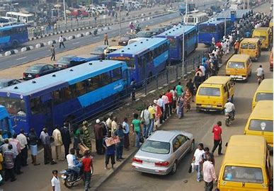
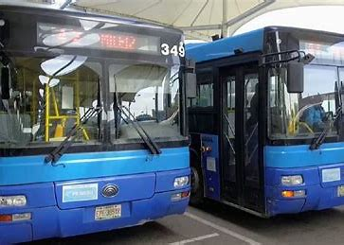
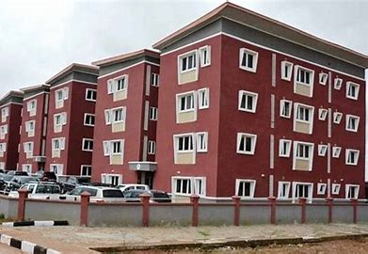
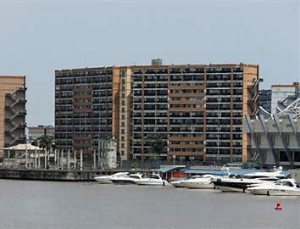
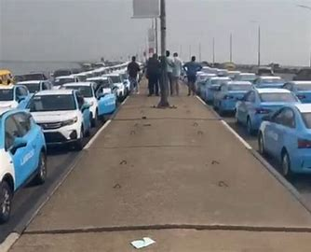
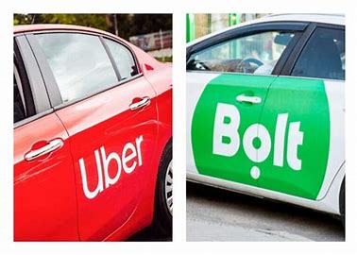
Existing Solutions to Commuting and Housing Challenges in Lagos
1
Improved Public Transportation Infrastructure - Bus Rapid Transit (BRT) System
2
Development of Affordable Housing Projects - Public-Private Partnerships (PPP)
"Public-private partnerships in Lagos have facilitated the development of affordable housing, addressing the significant housing deficit in the city" (Ibem, 2011).
3
Improved Public Transportation Infrastructure - Ride-Hailing Platforms
"Ride-hailing services have emerged as a significant alternative to traditional public transportation in Lagos, offering flexibility and convenience to commuters" (Afolabi & Gbadamosi, 2017).

Slide 30
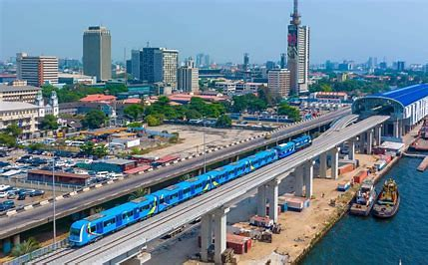
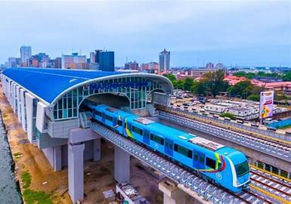

Existing Solutions to Commuting and Housing Challenges in Lagos
4
Expansion of Rail Services - Lagos Light Rail Project
"The Lagos Light Rail Project is expected to significantly enhance public transportation efficiency and reduce congestion on key commuter routes" (Olukoju, 2003).
5
Employee Shuttle Services - Corporate Shuttle Services
"Employee shuttle services have been shown to effectively reduce traffic congestion and improve commuting efficiency for corporate workers" (Adeola, 2010).

